Slide 1
Domain Name System (DNS)
To identify an entity, TCP/IP protocols use the IP address, which uniquely identifies the connection of a host to the Internet.
However, people prefer to use names instead of numeric addresses. Therefore, the Internet needs to have a directory system that can map a name to an address.
This is analogous to the telephone network. A telephone network is designed to use telephone numbers, not names. People can either keep a private file to map a name to the corresponding telephone number or can call the telephone directory to do so.

Slide 2
Domain Name System (DNS) (Getting the IP address of FTP server)
Six Steps followed to map Name to an IP address
User passes the host name to the file transfer client.
File transfer client passes host name to DNS client.
DNS client sends the message to DNS server with a query about file transfer server name using the known IP address of the DNS server.
DNS server responds with the IP address of the desired file transfer server.
DNS client passes this(IP) to the file transfer client.
File transfer (FTP) client gets the required IP to access the file transfer (FTP) server.

Slide 3
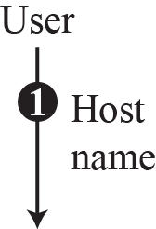
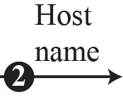
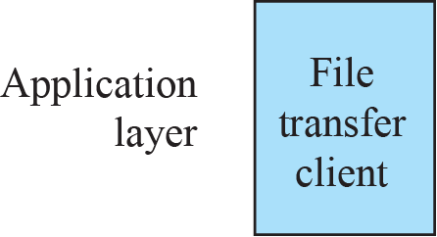
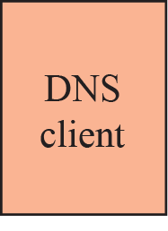

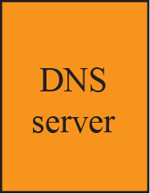
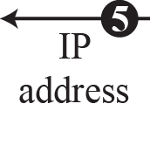

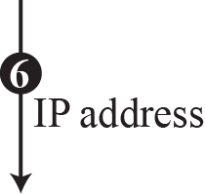

Before FTP client connect to FTP server ,We need to connect DNS client to DNS Server
Purpose of DNS

Slide 4
Name space
Names must be unique because addresses are unique.
A Name space that maps each address to a unique name , can be organized in two ways
Flat name space – A name is assigned to an address. no structure, sequence of characters.
Hierarchical name space – well suited for large systems like internet (duplication must be avoided), Each name is made of several parts.
First part define the nature of organization,
Second part define the type of organization,
Third part define the departments in the organization, and so on.

Slide 5
Domain Namespace
Domain Namespace is a name service provided by the Internet for TCP/IP.
DNS is broken up into domains, a logical organization of computers that exist in a larger network. Below is an example of the hierarchy of domain naming on the Internet.

Slide 6
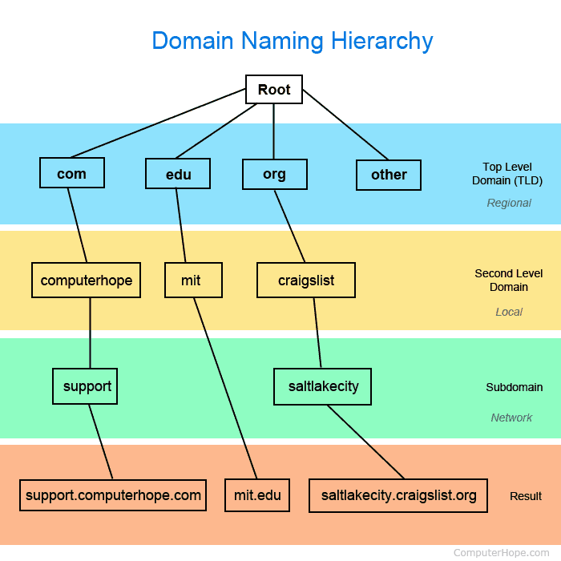
In the example, all websites are broken into regional sections based on the top level domain (TLD). In the example of http://support.computerhope.com it has a ".com" TLD, with "computerhope" as its second level domain that is local to the .com TLD, and "support" as its subdomain, which is determined by its server.

Slide 7
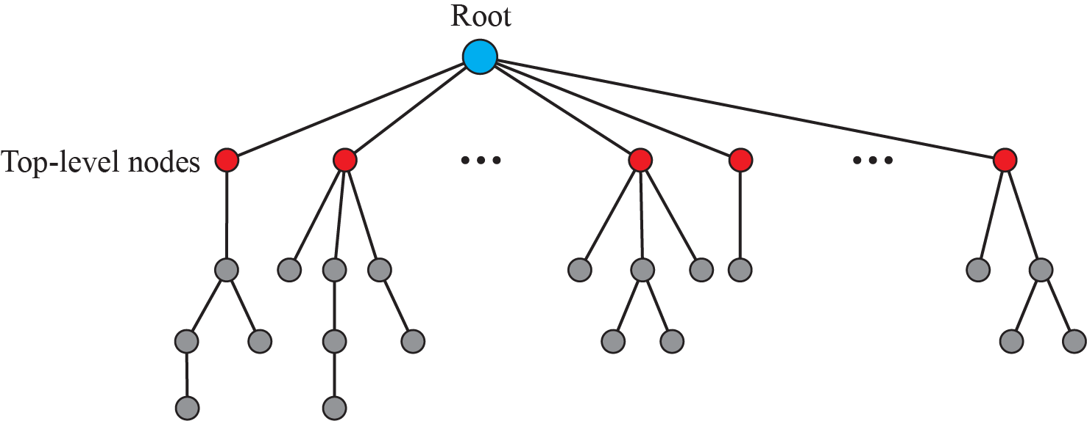
Domain name space
DNS has an inverted tree structure with the root at the top
Maximum 128 (0 – 127) levels
Each node has different labels – Max 63 characters
Root label is a null string

Slide 8
Domain Names and Labels
Label—Each node in the tree has a label.
Which is a string with a maximum of 63 characters.
Root label is a null string.
Labels must be unique within its parent domain
Each node in the tree has a domain name.
A full domain name is a sequence of labels separated by dots.
Read the domain names from the node up to the top(root).
The last label is the label of the root(null).
Last character is a dot because the null string is nothing.

Slide 9
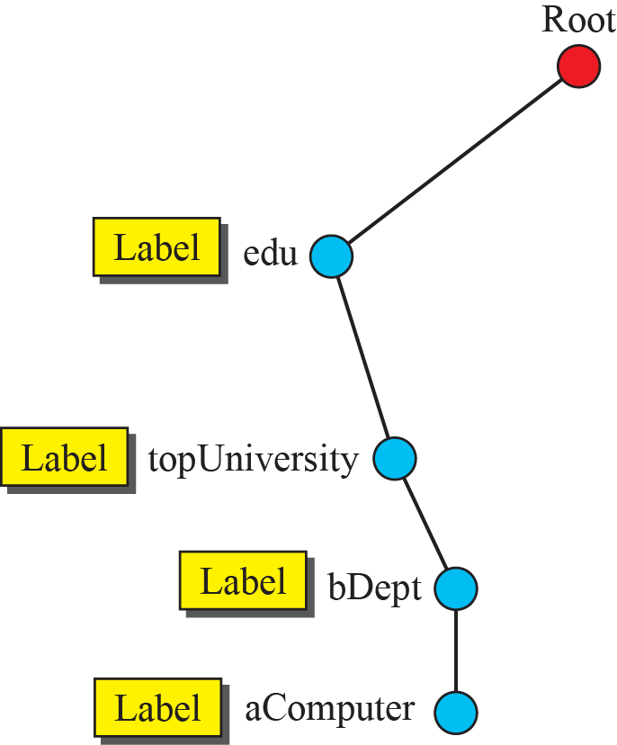
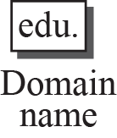



Domain names and labels

Slide 10
Domain names and labels
FQDN (Fully Qualified Domain Name) label terminated by null string.
EX---pc15.tek.omnisecu.com.
2. PQDN (Partially Qualified Domain Name) not terminated by a dot. A PQDN starts from a node, but it does not reach a root.
EX---pc15.

Slide 11

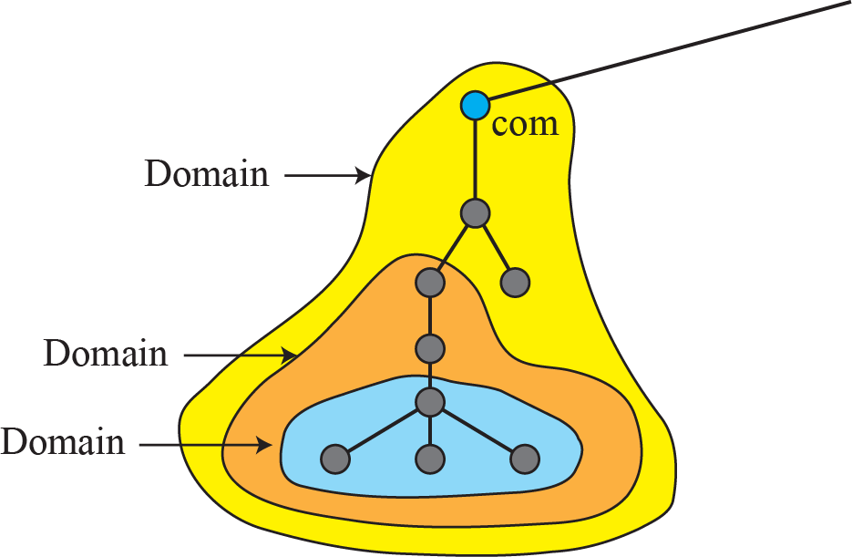
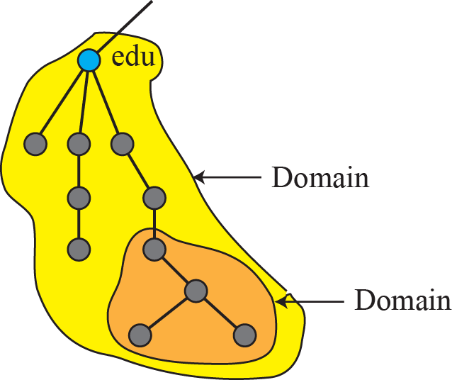
Domains
A Domain is the subtree of the Domain Name space.
The name of the domain is the name of the node at the top of the subtree.

Slide 12
Hierarchy of name servers
Information is distributed among several computers called DNS servers .
Domains can be subdivided into smaller subdomains.
Each server is responsible (authoritative)for larger or smaller domains called Zones.
Zone server makes a database called a Zone File and keeps all the information for every node under that domain .

Slide 13
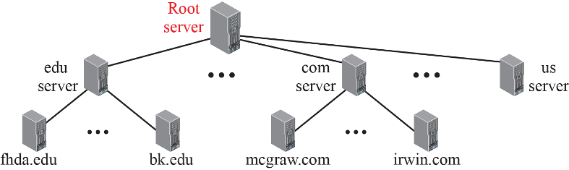

Slide 14
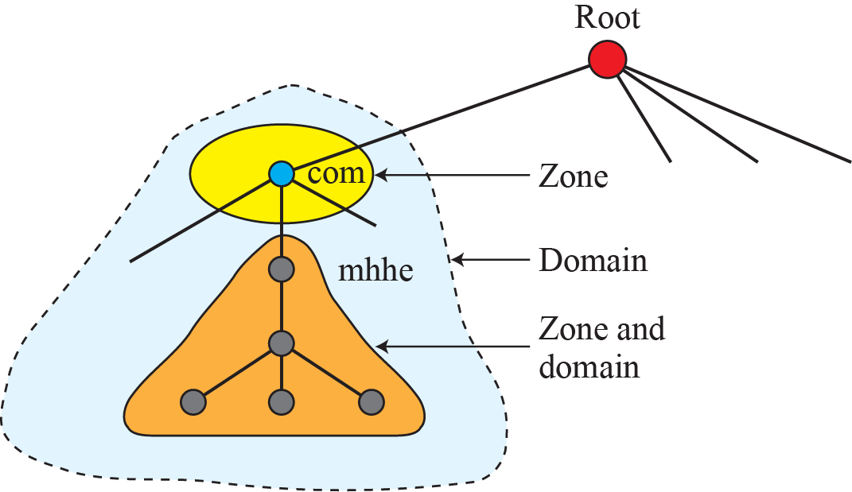
Zone

Slide 15
Root Server
A root server is a server whose zone consists of the whole tree. It delegates authority to other servers by keeping references to those servers.
There are several Root Servers. Root servers are distributed all over the world.
Primary and Secondary servers.
-

Slide 16
Root Server
Primary server stores the zone file for which it is an authority and is responsible for creating, maintaining and updating the zone file.
2. A Secondary server transfers complete information about a zone from another server. It neither creates nor update zone files (it loads information from primary server).
NOTE--- A primary server for one zone could be the secondary server for another zone.

Slide 17
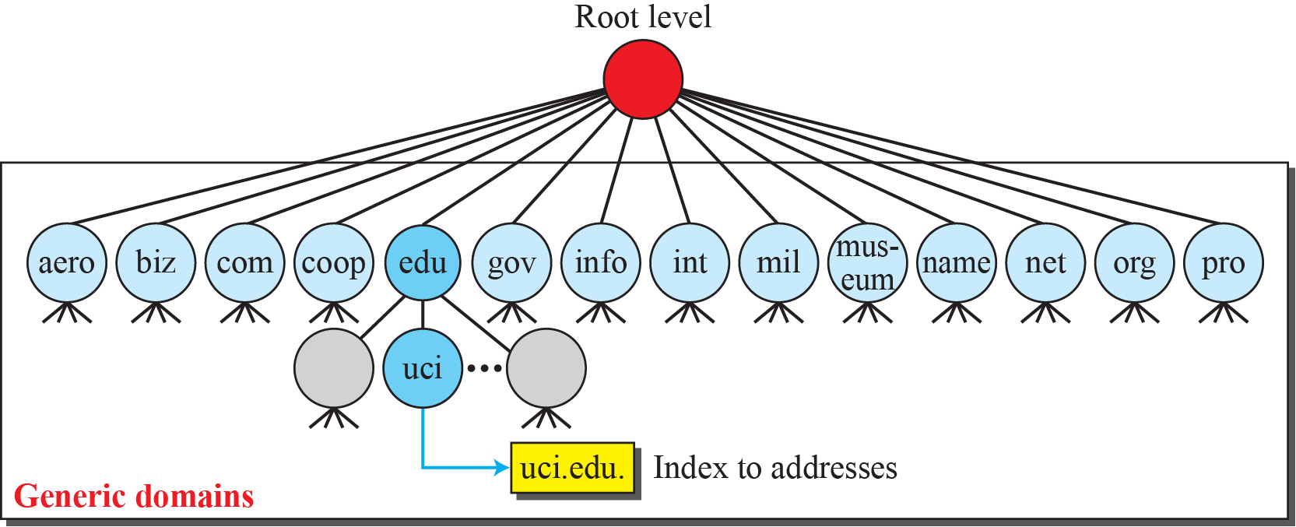
Generic domains
DNS in the Internet
DNS protocol is divided into three sections – Generic domains, Country Domains and Inverse domains.

Slide 18
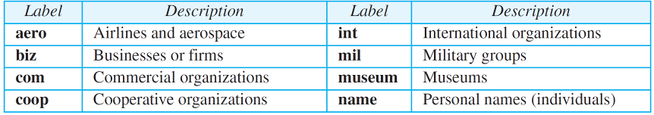

Generic domain labels
14 possible labels are there

Slide 19
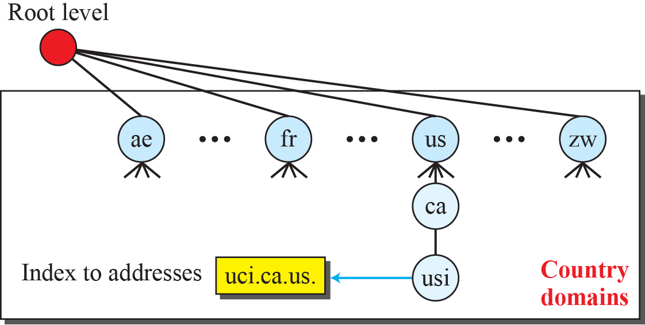
Country domains

Slide 20
Resolution
Mapping a name to an address is called Name-address resolution.
Client is called the resolver.
It can be Recursive or Iterative resolution.

Slide 21

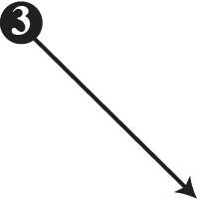
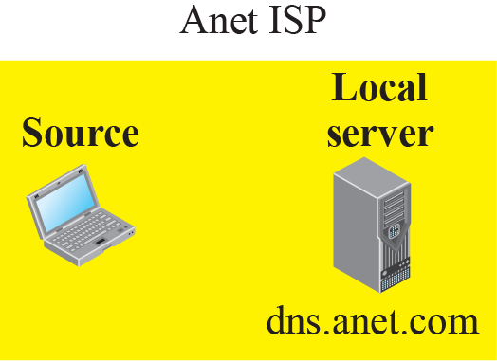
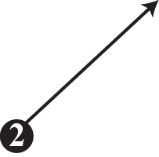
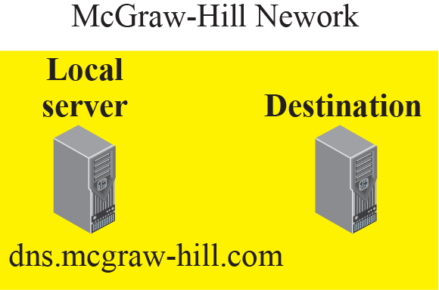



Figure : Recursive resolution

Slide 22
Iterative resolution
Here each server that does not know the mapping ,sends the IP address of the next server back to the requester. Here events 2, 4, 6 contains the same query.

Slide 23
Caching
Each time a server receives a query for a name that is not in its domain, it needs to search its database for a server IP address. Reduction of this search time would increase efficiency. DNS handles this with a mechanism called caching.
When a server ask for a mapping from another sever and receives the response, it stores the information in Cache memory.
It speeds up resolution but it may be a stale information.
To indicate that it is mentioned as unauthoritative and attached with TTL(Time To Live).

Slide 24
Resource Records
The zone information associated with a server is implemented as a set of resource records.
A name server stores a database of resource records.
Resource Records is a 5-tuple structure
(Domain name, Type, Class, TTL, Value)
Domain Name - Identification for resource records.
value - Information kept about the domain name.
Class - Type of network (IN for Internet).
TTL – Time To Live in seconds(valid).
Type – How the value should be interpreted, as shown below

Slide 25
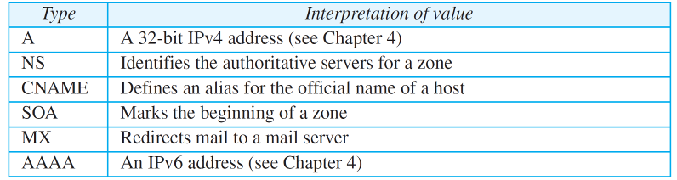
Resource Records

Slide 26
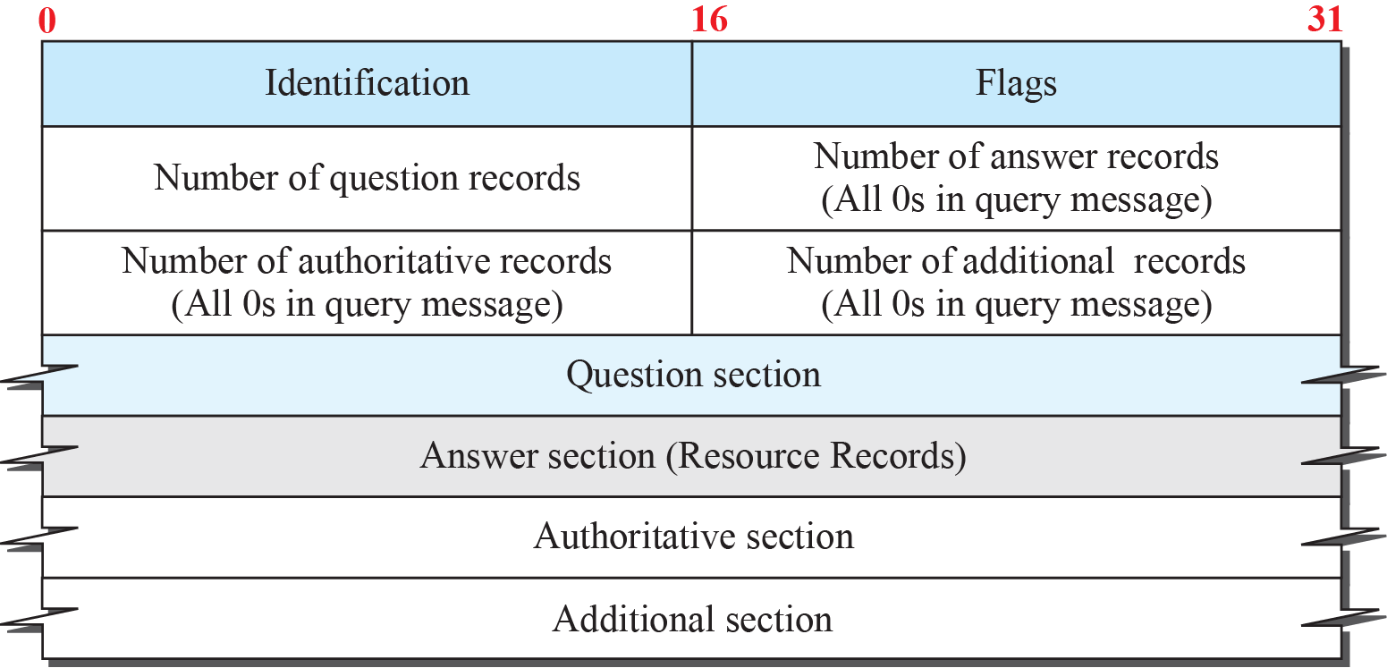

DNS Messages
To retrieve information about hosts, DNS uses two types of messages – Query message and Response message- both have same format.

Slide 27
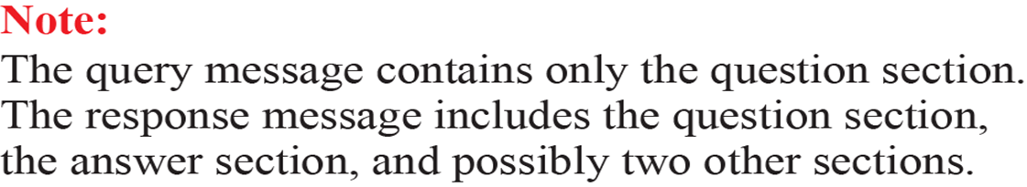
DNS Messages
Identification field is used by the client to match the response with the query.
Flag field defines whether the message is a query /response, also includes status of error.

Slide 28
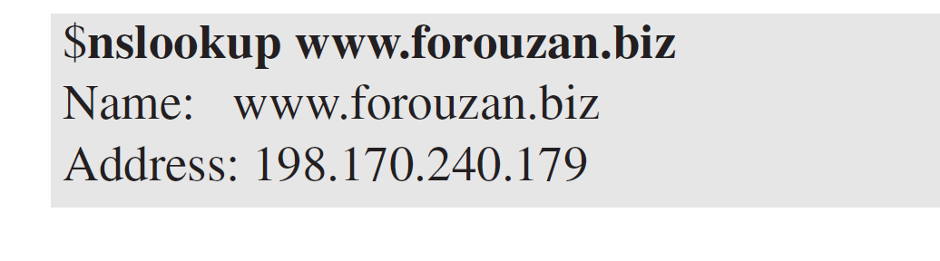
Example 2.14
In UNIX and Windows, the nslookup utility can be used to retrieve address/name mapping. The following shows how we can retrieve an address when the domain name is given.

Slide 29
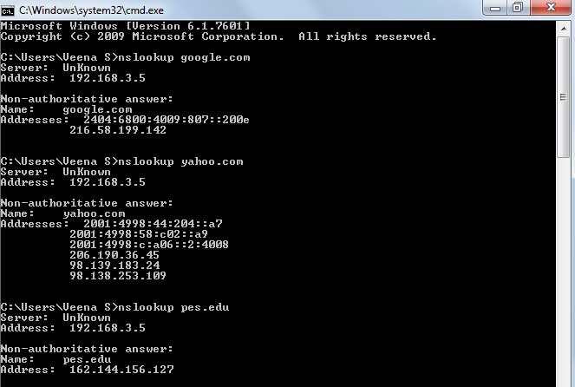

Slide 30
PEER-TO-PEER PARADIGM
Peer-to-peer gained popularity with Napster(1999-2001) , an online music file sharing service created by Shawn Fanning.
It paved the way for peer-to-peer file-distribution models that came later.
Gnutella was followed by Fast-Track, BitTorrent, WinMX, and GNUnet.

Slide 31
P2P Networks
Internet users that are ready to share their resources become peers and form a network.
When a peer in the network has a file to share, it makes it available to the rest of the peers.
An interested peer can connect itself to the computer where the file is stored and download it. After a peer downloads a file, it can make it available for other peers to download.
As more peers join and download that file, more copies of the file become available to the group.
Two categories of P2P networks—Centralized and Decentralized.

Slide 32
1. Centralized Networks
The directory system-- listing of the peers and what they offer-- uses the client-server paradigm, but storing and downloading uses the P2P paradigm.
It is also called as Hybrid P2P network .
Example-- Napster(pay-for-music site)
Drawbacks:
- huge traffic for central server
- central servers are vulnerable to attack

Slide 33
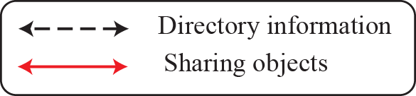
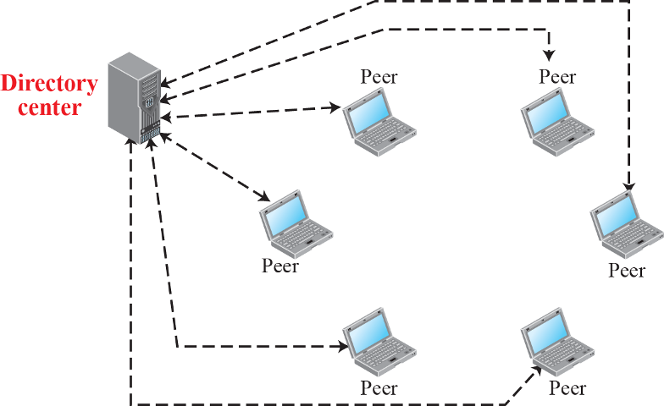
Centralized network

Slide 34
2.Decentralized Network
A decentralized P2P network does not depend on a centralized directory system.
Peers form a overlay network (logical network made on top of physical network).
Depending on how the nodes in the overlay network are linked. It is classified as two categories:
Unstructured Networks
Structured Networks

Slide 35
I. Unstructured Networks
Unstructured Networks – nodes linked randomly, A search in an unstructured P2P is not very efficient because a query to find a file must be flooded through the network.
Which produces significant traffic and still the query may not be resolved.
Eg : Gnutella, Freenet

Slide 36
II. Structured Networks
Structured Networks – uses a predefined set of rules to link nodes so that a query can be resolved effectively and efficiently.
Uses DHT(Distributed Hash Tables)
Eg: Bit Torrent

Slide 37
SOCKET-INTERFACE PROGRAMMING
In this section, we show how to write some simple client-server programs using C, a procedural programming language.

Slide 38
Socket Interface in C
How this interface is implemented in the C language. The important issue in socket interface is to understand the role of a socket in communication.
The socket has no buffer to store data to be sent or received. It is capable of neither sending nor receiving data.
The socket just acts as a reference or a label. The buffers and necessary variables are created inside the operating system.

Slide 39
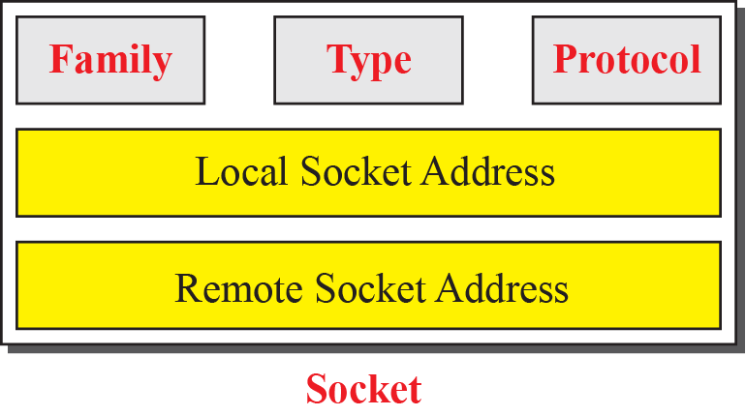
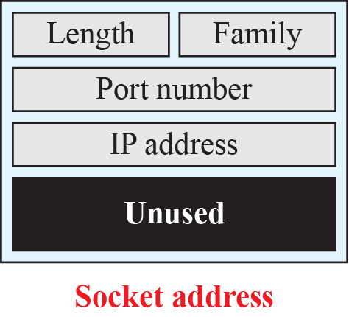
Data Structure for Socket
The c language defines a socket as a structure -made of 5 fields .
It is defined in the header files.

Slide 40
Family ---This field defines the family protocol(How to interpret the addresses and port number). The common values are PF_INET for current Internet and PF_INET6 for next generation internet.
Type –This field defines 4 types of sockets
SOCK_STREAM for TCP
SOCK_DGRAM for UDP
SOCK_SEQPACKET for SCTP
SOCK_RAW for apps directly use the services of IP
Protocol –This field defines the specific protocol in the family .It is set to 0 for TCP/IP protocol suite because it is the only protocol in the family.

Slide 41
Local Socket Address ---This field defines the local socket address.
A socket address is itself a structure made of the length field, the family field(which is set to the constant AF_INET for TCP/IP protocol suite).
The port number field--which defines the process.
The IP address field--which defines the host on which the process is running.
It also contains an unused field.
Remote Socket Address —Its structure is same as local socket address.

Slide 42
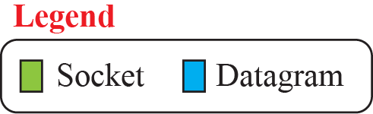
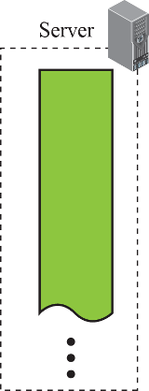
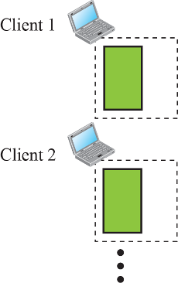
Sockets for UDP communication
Observe the lifetime of sockets in the client and server process.

Slide 43
Sockets for UDP communication
UDP provides a connectionless server.
In UDP communication ,Server and client uses only one socket each.
The socket created at the server site lasts forever, The socket created at the client site is closed when the client process terminates.

Slide 44
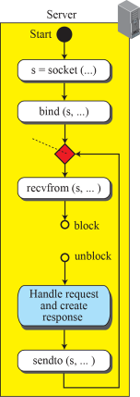
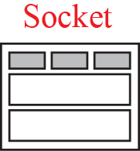
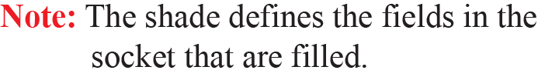
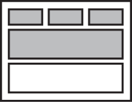
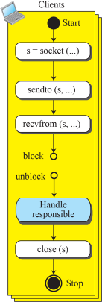
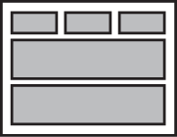
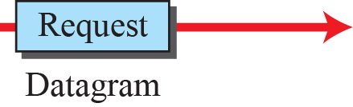
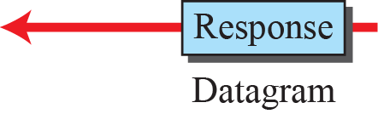
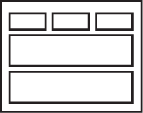
Flow diagram for iterative UDP communication

Slide 45
Server – does passive open
creates socket – (fills first three fields)
calls bind procedure – (fills local socket address)
calls recvfrom - blocks until datagram arrives
unblocks when datagram arrives and fills remote socket
process the request, creates response and sends it by calling sendto, waits for another request.
Client does active open.
creates socket – (fills first three fields)
selects a temporary port for the client, and calls sendto to send request. Then calls recvfrom which blocks the process until it receives datagram.
Finally close procedure is called to destroy the socket.

Slide 46
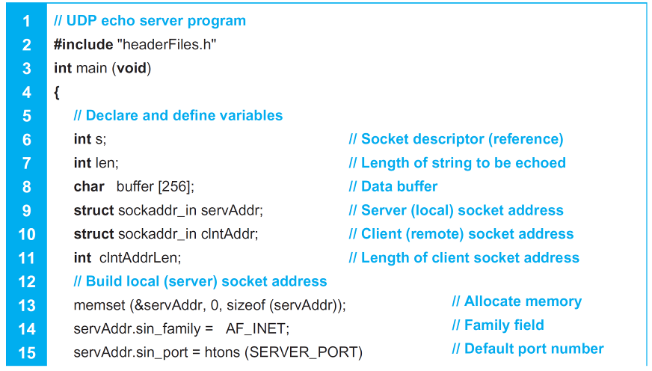

Table 2.22: Echo server program using UDP
2.46

Slide 47
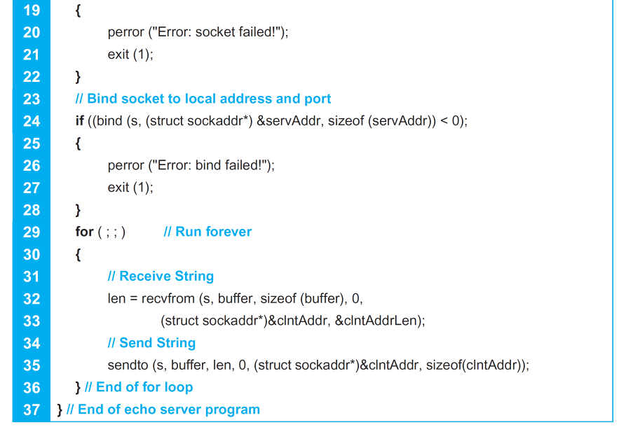
Table 2.22: Echo server program using UDP (continued)
2.47

Slide 48
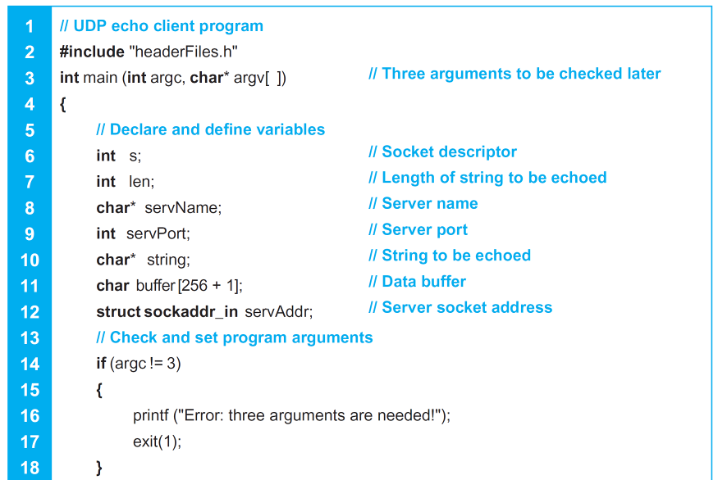
Table 2.23: Echo client program using UDP
2.48

Slide 49
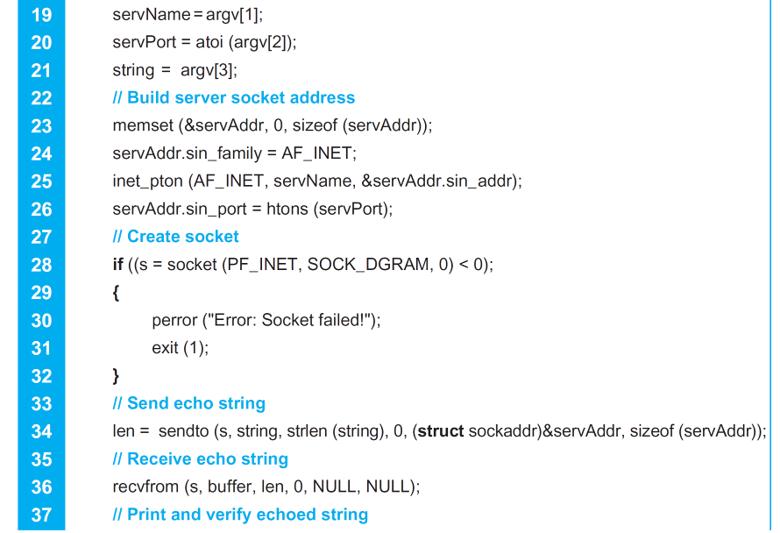
Table 2.23: Echo client program using UDP (continued)
2.49

Slide 50
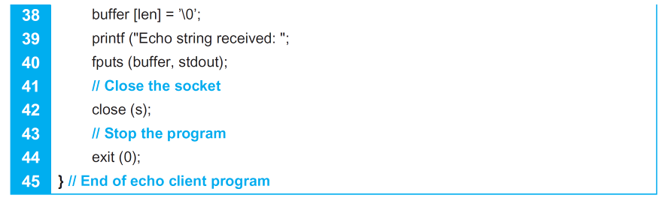
Table 2.23: Echo client program using UDP (continued)
2.50

Slide 51
Communication using TCP
TCP is a connection oriented protocol
Follows 3 steps
- Connection establishment
- Data transfer
- Connection Termination
TCP server uses two sockets, one for connection establishment (listen socket), and other for data transfer (socket)
Client uses only one socket.

Slide 52
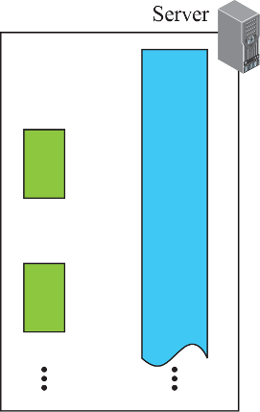
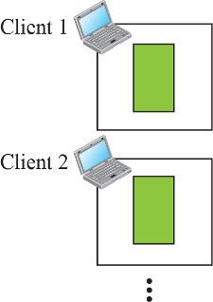



Sockets used in TCP communication

Slide 53












Flow diagram for iterative TCP communication

Slide 54
Server – does passive open (first 2 steps same as UDP, but they create listen socket used for connection establishment)
creates socket – (fills first three fields)
calls bind procedure – (fills local socket address)
calls listen procedure to start accepting clients requests (completes connection phase and put it to waiting queue – normally max 5 allowed)
server process starts serving the clients one by one
calls accept procedure which connects with one client in the waiting list, and servesit. When it returns creates a new socket fills remote socket address

Slide 55
client and server can exchange data by using send and recv (simpler than sendto and recvfrom) may be several times
Client flow is almost similar to UDP
Client does active open.
creates socket – (fills first three fields) , calls connect to connect to server
Finally either client or server calls close procedure to destroy the socket.

Slide 56


Figure : Flow diagram for data-transfer boxes

Slide 57

Table 2.24: Echo server program using the services of TCP
2.57

Slide 58


Table 2.24: TCP Echo server program(continued)
2.58

Slide 59

Table 2.24: TCP Echo server program (continued)
2.59

Slide 60

Table 2.25: Echo client program using the services of TCP
2.60

Slide 61

Table 2.25: TCP Echo client program (continued)
2.61

Slide 62

Table 2.24: TCP Echo client program(continued)
2.62

Slide 63
Chapter 2: Summary
Applications in the Internet are designed using either a client-server paradigm or a peer-to-peer paradigm. In a client-server paradigm, an application program, called a server, provides services and another application program, called a client, receives services. A server program is an infinite program; a client program is finite. In a peer-to- peer paradigm, a peer can be both a client and a server.
The World Wide Web (WWW) is a repository of information linked together from points all over the world. Hypertext and hypermedia documents are linked to one another through pointers. The HyperText Transfer Protocol (HTTP) is the main protocol used to access data on the World Wide Web (WWW).

Slide 64
Chapter 2: Summary (continued)
File Transfer Protocol (FTP) is a TCP/IP client-server application for copying files from one host to another. FTP requires two connections for data transfer: a control connection and a data connection. FTP employs NVT ASCII for communication between dissimilar systems.
The Domain Name System (DNS) is a client-server application that identifies each host on the Internet with a unique name. DNS organizes the name space in a hierarchical structure to decentralize the responsibilities involved in naming.

Slide 65
Chapter 2: Summary (continued)
In a peer-to-peer network, Internet users that are ready to share their resources become peers and form a network. Peer-to-peer networks are divided into centralized and decentralized.
Socket Interface Programming – UDP communication and TCP communication

